Slide 1



Winter School for Theoretical Chemistry and Spectroscopy
25/11/2024
Inorganic Systems Engineering
Department of Chemical Engineering, Delft University of Technology, The Netherlands
Workshop: ML-ready representations for homogeneous catalysis
Adarsh Kalikadien

Slide 2
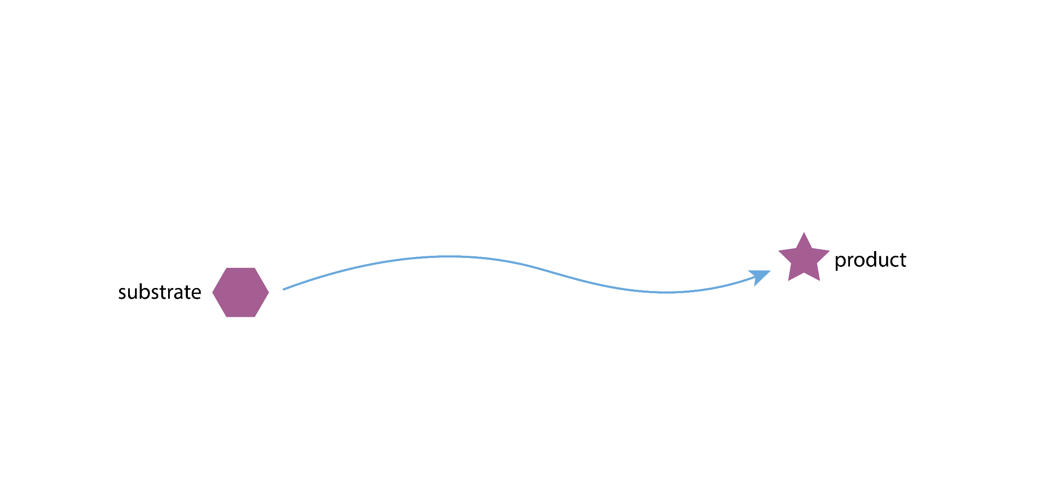
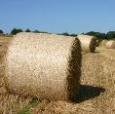

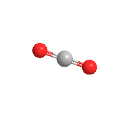
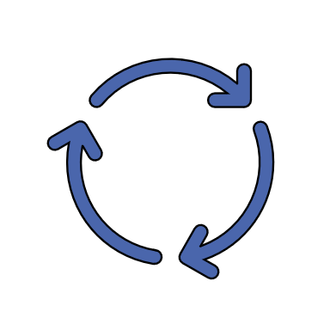
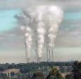
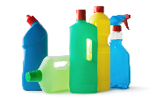
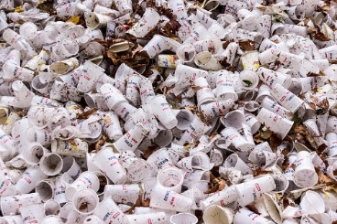
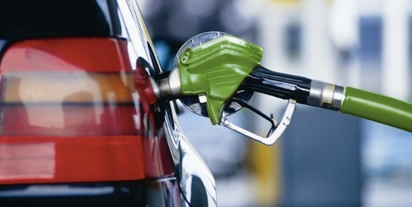
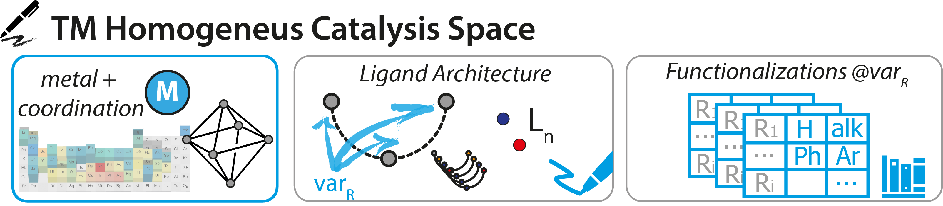
Homogeneous catalysis = Molecular Inorganic Chemistry: should be easy to design!
CAT

Slide 3
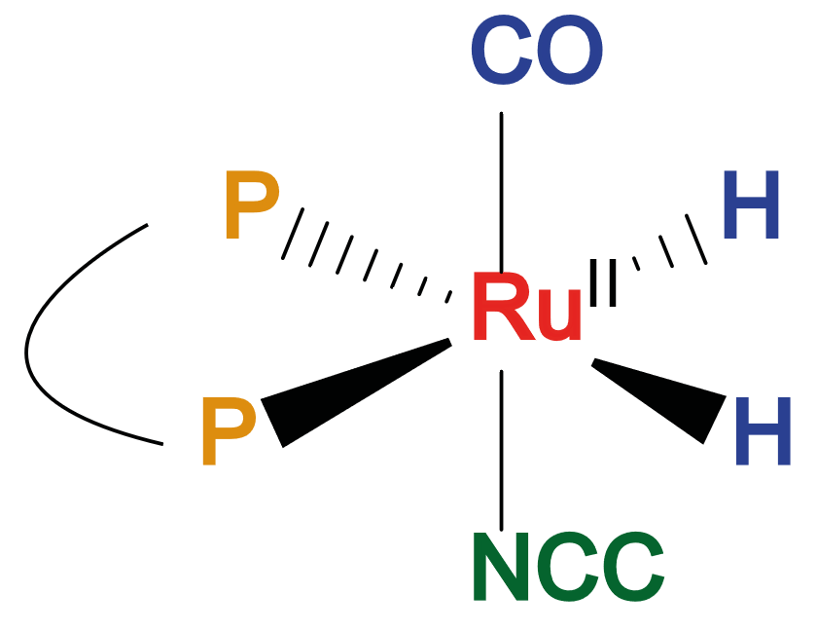
Example of metal-ligand complex
Octahedral
Metal center
Bidentate ligand
Auxiliary ligand
Substrate

Slide 4
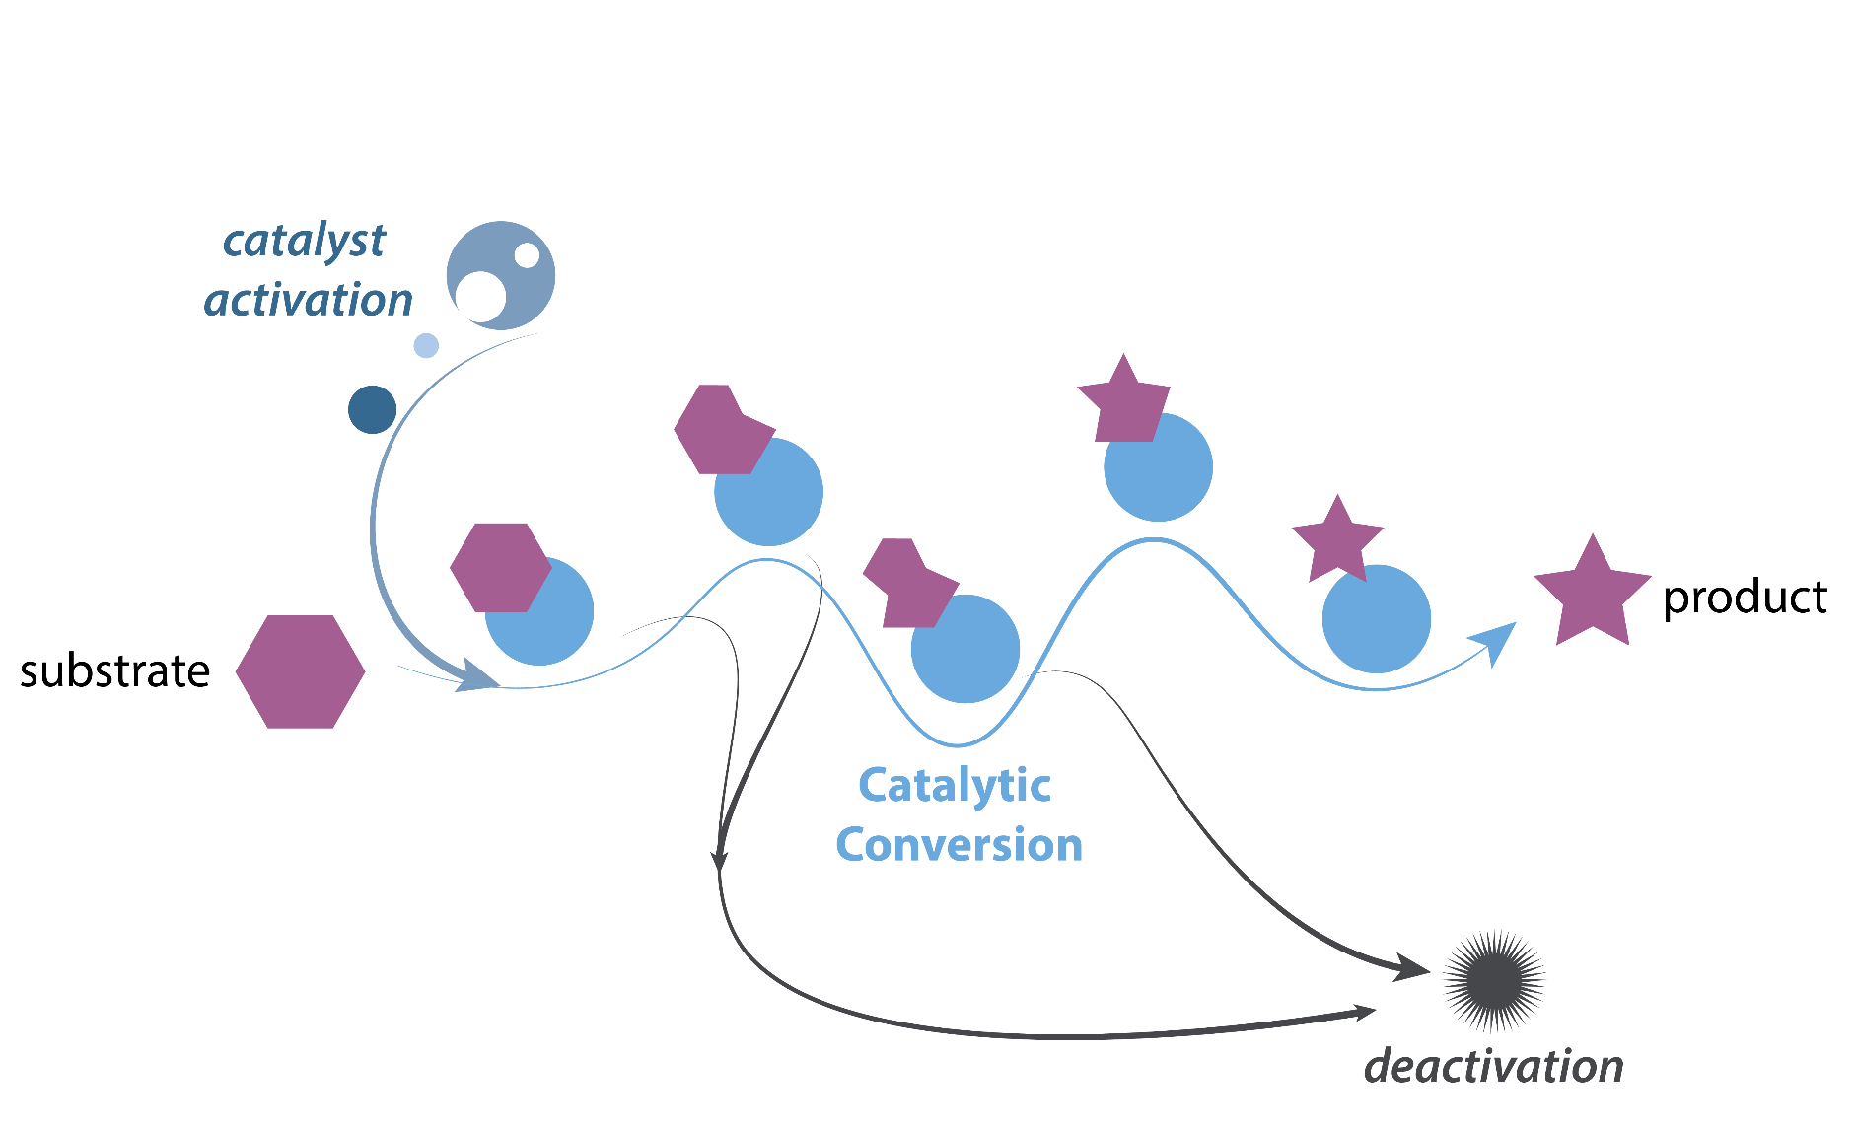
Molecular definition of a catalyst
What is the catalyst?
Catalytic species form in situ and evolve during the reaction
The catalyst is defined by the nature of pre-catalyst and reaction conditions
Common problem for homogeneous and heterogeneous catalysis
What makes it active?
How does it die?
Yang, Filonenko, Pidko, ChemCommun 2023, 59, 1757

Slide 5
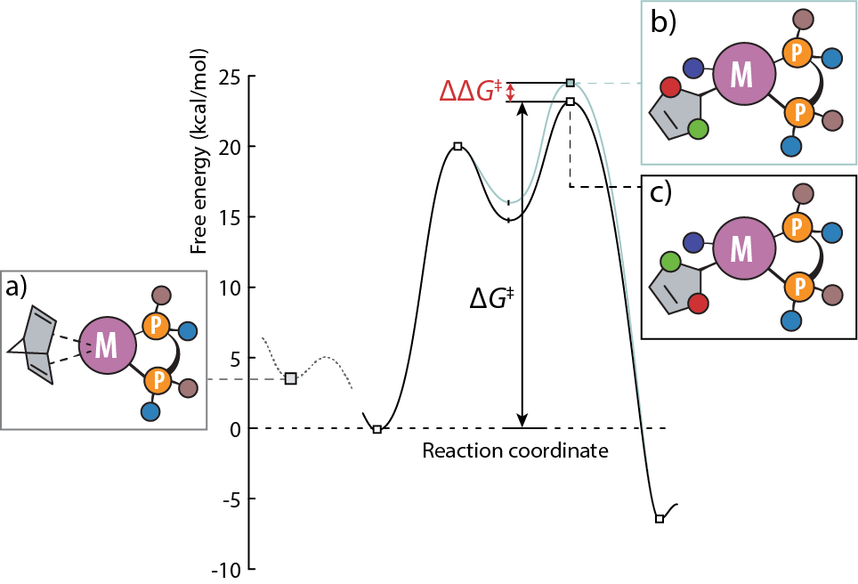

Mechanism-agnostic vs. Mechanism-based approach
Mechanism-agnostic
Precatalyst (a)
Generalizable
Reaction dynamics are lost
Deep understanding of dataset
Mechanism-based
Competing TSs (b) and (c)
Outstanding performance for selectivity
Knowledge about TS and mechanism
Very specific
Kalikadien, Mirza, Najl Hossaini, Sreenithya, Pidko, ChemPlusChem 2024, e202300702

Slide 6

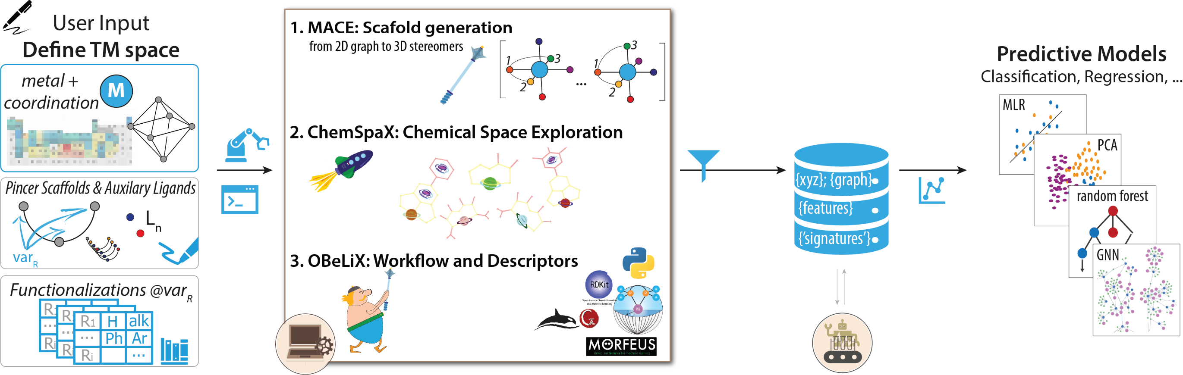

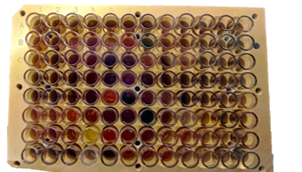
Automation for computational catalysis
MACE: Chernyshov, Pidko, JCTC 2024, 20, 2313
ChemSpaX: Kalikadien, Pidko, Sinha, Digital Discovery 2022, 1, 8
OBeLiX: Kalikadien, Mirza, Najl Hossaini, Sreenithya, Pidko, ChemPlusChem 2024, e202300702

Slide 7


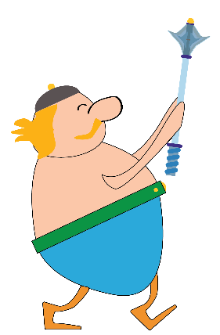

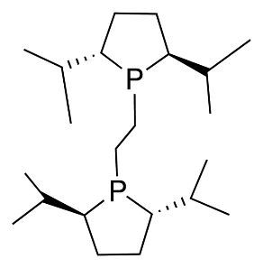
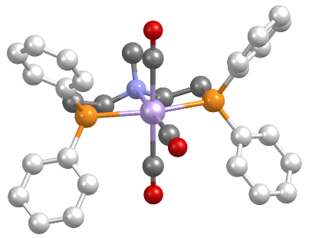
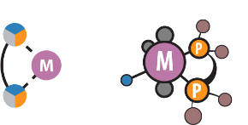

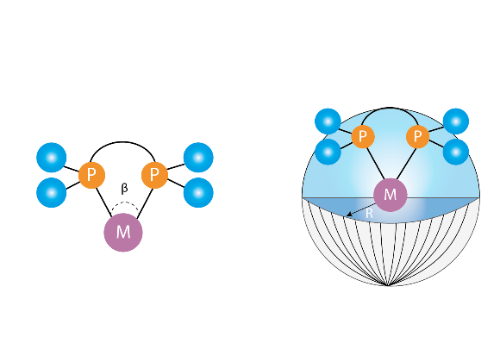
From the lab notebook to computer
Building blocks or structures
Descriptors
Geometric/steric
Bond distances
Cone angle
Bite angle
Buried volumes
…
Electronic/thermodynamic
NBO charges
Mulliken charges
Lone pair occupancies
(Anti)bonding orbital occupancies
Dipole
HOMO
LUMO
…
OBELIX
Notes:
The vision is simple, we want to enable a chemist to use their intuitive drawing of the catalytic reaction and have the descriptors as output. So given just the building blocks or the full structure, we should be able to transform them into a representation for use in statistical methods. Some examples of these descriptors are … and these can then be used to represent the catalyst in ML algorithms

Slide 8
Our first attempt: HTE + ML

Slide 9


Our first attempt – HTE + ML
Can the machine learn the important features of chemistry and extrapolate to new ligands or substrates?
Combinatorial approach
24 catalysts
12 bases
12 solvents
Temperature
Ratio coupling
Coupling partners
Amount of base
> 3000 experiments
> 24000 experiments
Hits for further research
Predictive approach
24 catalysts
12 bases
12 solvents
< 100 experiments
Hits for further research

Slide 10
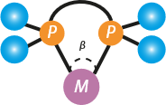
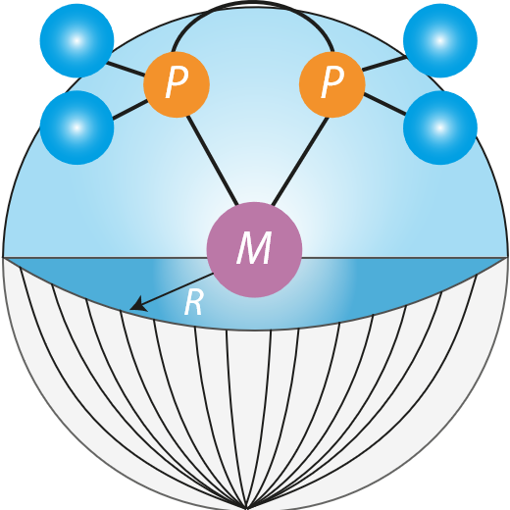
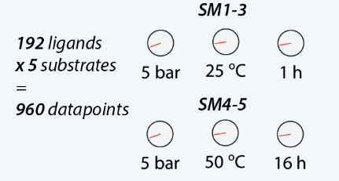
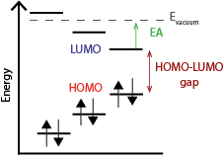
Our first attempt – HTE + ML
Model catalysts
DFT
Gaussian 16
Opt: PBE0-D3(BJ)//def2-SVP
SP: PBE0-D3(BJ)//def2-TZVPP
Descriptors
Geometric
Steric
+
Substrate representation
Target for modelling
Electronic
Kalikadien, Valsecchi, van Putten, Maes, Muuronen, Dyubankova, Lefort, Pidko, Chem. Sci. 2024

Slide 11
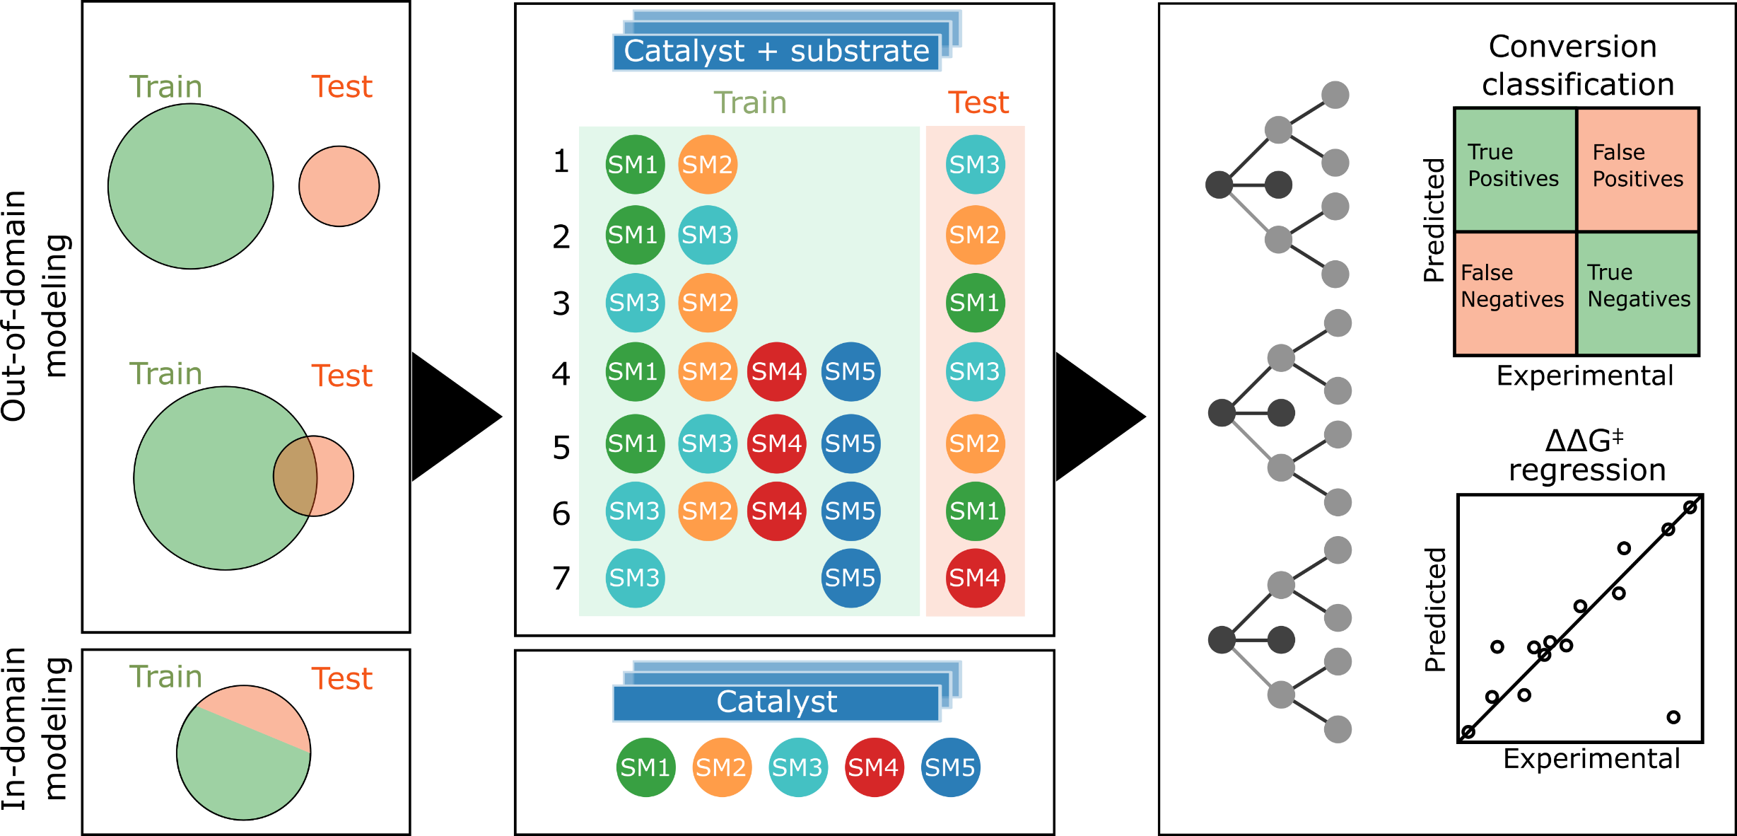
Our first attempt – HTE + ML
Random forest
Kalikadien, Valsecchi, van Putten, Maes, Muuronen, Dyubankova, Lefort, Pidko, Chem. Sci. 2024

Slide 12
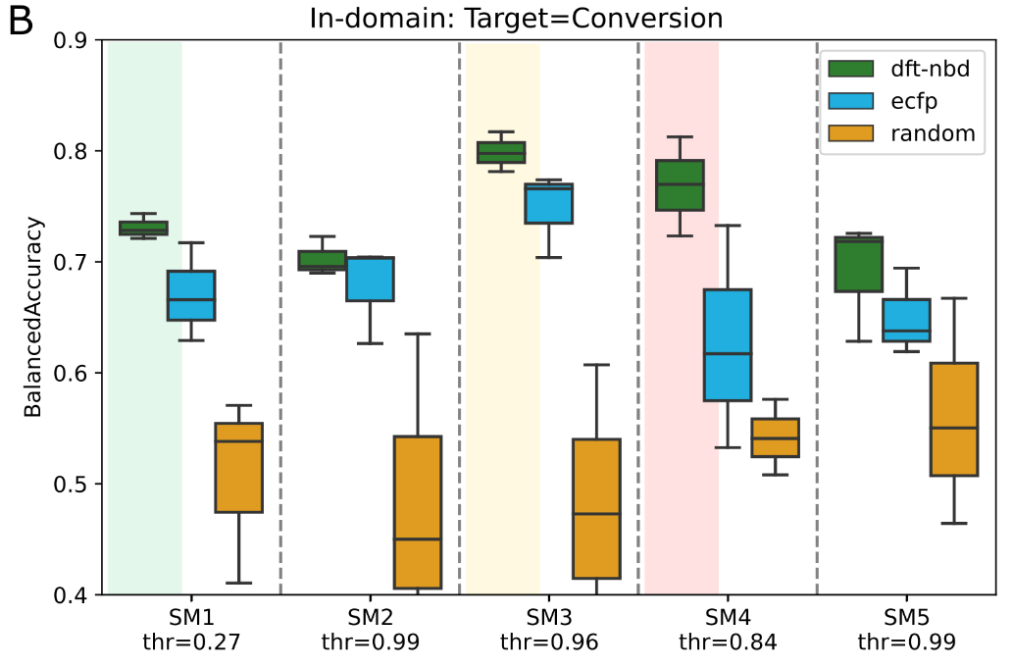

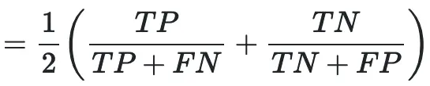
Our first attempt – HTE + ML
Simple representations sometimes work as well as DFT-based representation
Depends modelling task and experimental data
Balanced accuracy

Slide 13

Our first attempt – HTE + ML
Can the machine learn the important features of chemistry and extrapolate to new ligands or substrates?
ML models are not always informative, what are the effects of our assumptions on the model structure and flexibility?

Slide 14
Replacing general substrate template

Slide 15

Substrate coordination – change in conformational ensemble
L-Rh-S
L-Rh-NBD
L-Rh-S Major 1
L-Rh-S Major 2
CREST
GFN-FF//GFN2-xTB
DFT
Gaussian 16
Opt: PBE0-D3(BJ)//def2-SVPP
L-Rh-NBD
L-Rh-S Minor 1
L-Rh-S Minor 2
Notes:
First step: conformer search on both substrate-specific and model system. Need to start with input structures. As mentioned, S is asymmetric, so different possibilities. Best visualized with quadrant diagram: catalyst with side groups, two point forwards, two back, so when looking from front--> two blocked and two open quadrants. Depending on how substrate coordinates more/less steric hindrance:
COOMe is part that will cause hindrance, can be placed in open quadrant (Major) and blocked quadrant (Minor). And can also fill other two, so in the end two major and two minor.
NBD: symmetric, so only one coordination.
Resulting in: per catalyst, five structures, 11 catalysts, so total 55 structures.

Slide 16
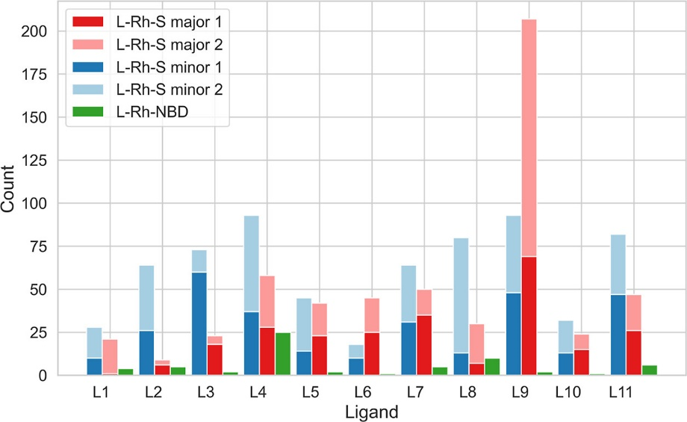
Substrate coordination – change in conformational ensemble
Effect of substrate on CREST conformer landscape?
L-Rh-S > L-Rh-NBD conformer
Substrate induces flexibility?

Slide 17
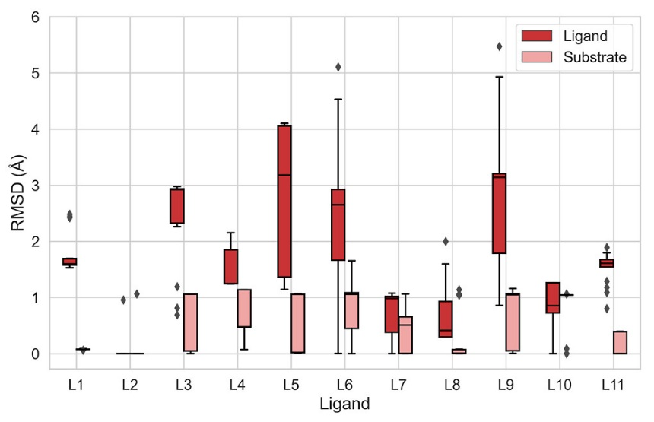
Substrate coordination – change in conformational ensemble
Where does flexibility come from?
Rigid substrate
Flexible ligand
Substrate induces ligand flexibility!

Slide 18
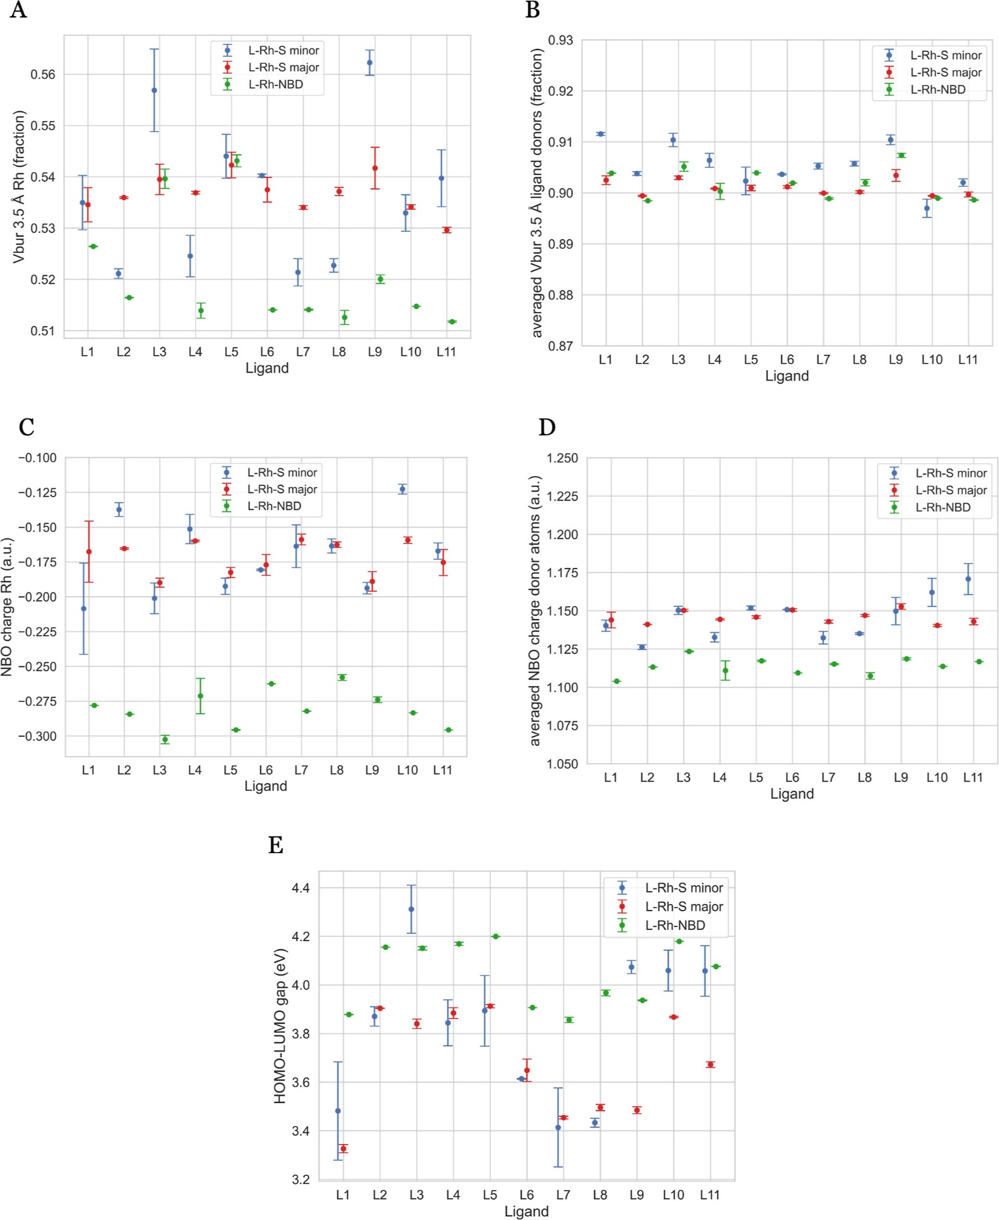
Substrate coordination – change in conformational ensemble
Effect of substrate on DFT-based descriptors?
Steric descriptors show minimal variation
HOMO-LUMO gap depends on coordinating substrate
Electronic descriptors depend on substrate coordination mode

Slide 19
Substrate coordination – change in conformational ensemble
Effect of substrate on CREST conformer landscape?
L-Rh-S > L-Rh-NBD conformer
Substrate induces flexibility
Where does flexibility come from?
Rigid substrate
Flexible ligand
Substrate induces ligand flexibility
Effect of substrate on DFT-based descriptors?
Steric descriptors show minimal variation
HOMO-LUMO gap depends on coordinating substrate
Electronic descriptors depend on substrate coordination mode
Notes:
Some effects in substrate-specific case not described by model catalyst. when substrate is included, whay more conformers generated with S than with NBD, so more flexible system. Flexibility mainly in ligand, which is missed in generic case. Flexibility has effect on chosen coordinating molecule, but also on initially chosen coordination mode.
Everything not as easy as it seems with just using generic system.

Slide 20
What if stereoisomery of the metal-ligand complex comes into play?

Slide 21
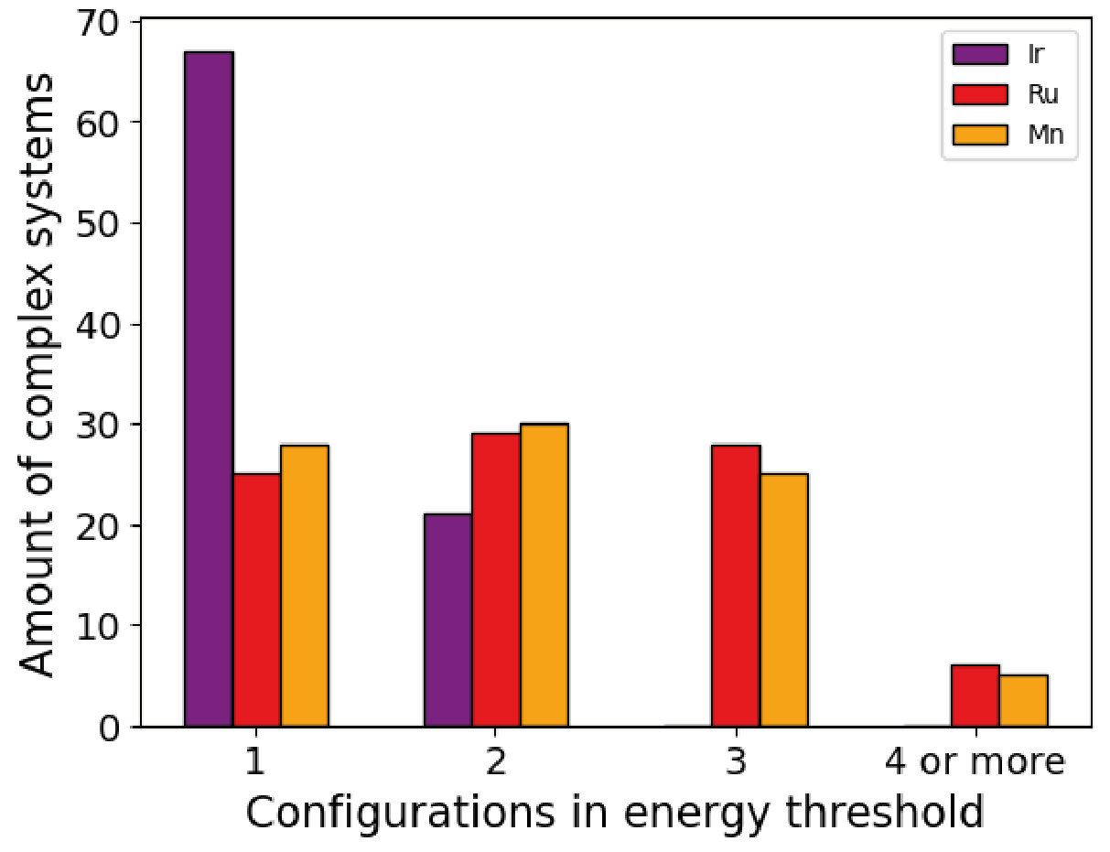
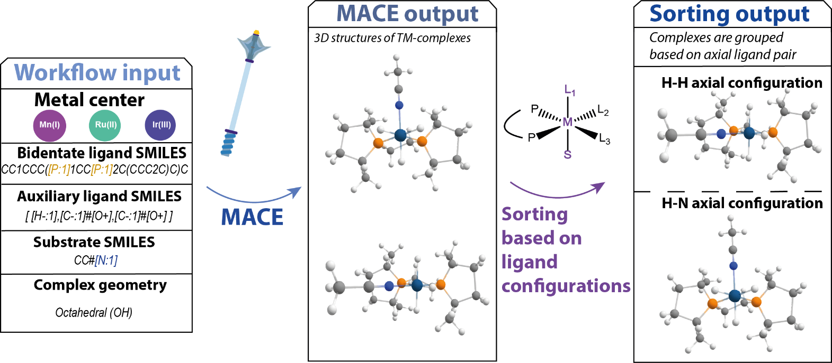
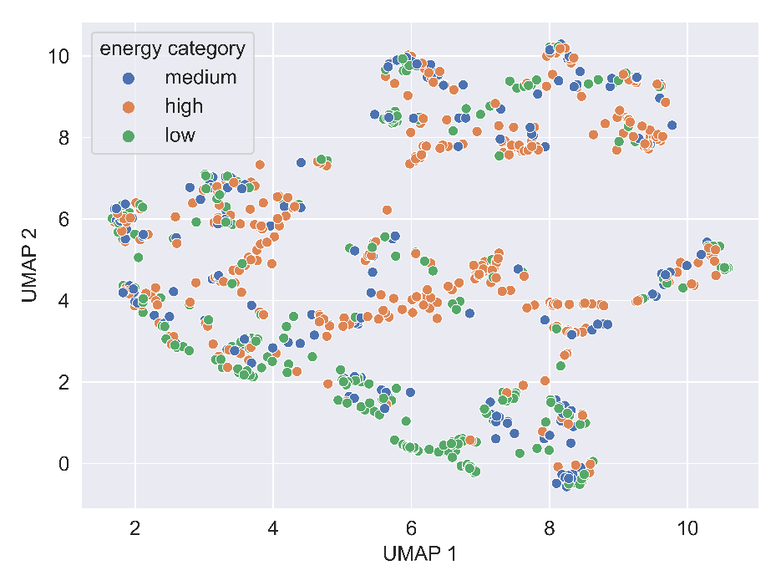
Switching arrangement of ligands – drown in data
Number of complexes
Configurations within 10 kJ/mol
Kalikadien, van der Lem, Pidko, in preparation

Slide 22
Summary
Tool for creating ML-ready representations based on physical chemical descriptors of homogeneous catalysts with bidentate ligands
Modelling performances depend heavily on underlying data
Be aware of assumptions in creation of representation

Slide 23

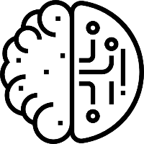
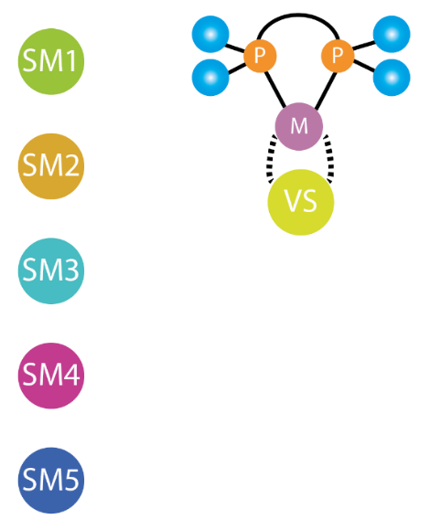

Current workflow
Data storage
Data generation
ML pipeline
Version control
Structures

Slide 24

First things first
OBeLiX requires a Unix-based operating system for descriptor calculation (due to xtb-python)
(optional) Windows subsystem for Linux (WSL)
Open CMD
wsl --install
Python
Anaconda or Miniconda
Git version control
`brew install git` on Mac
`apt-get install git` on Linux
Follow the installation instructions to get all code & data
https://github.com/EPiCs-group/obelix-tutorial/

Slide 25
OBeLiX cloning and installation
Clone repository from Github
git clone https://github.com/EPiCs-group/obelix
Go into obelix directory
cd obelix
Create conda environment with required packages
If not on Unix system: # in front of xtb-python in environment.yml
conda env create –f environment.yml
Activate conda environment
conda activate obelix
Install jupyter notebook package to enable running of Jupyter notebooks
pip install notebook
Install obelix as a package in this environment
pip install –e .

Slide 26
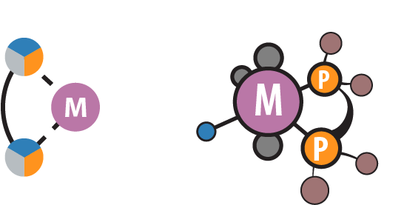

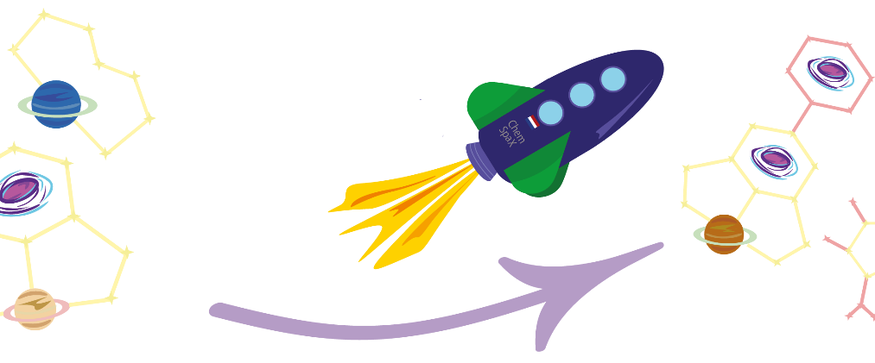
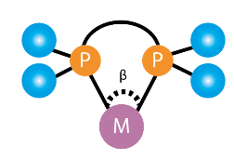

OBeLiX
Catalyst structure generation
MACE
Conformer sampling
CREST
OBELIX
Catalyst structure modification
ChemSpaX
DFT optimization
Gaussian
Descriptor calculation
Morfeus/in-house scripts

Slide 27

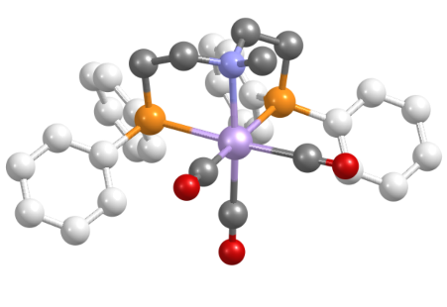
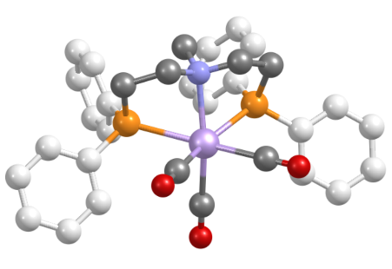
MACE (MetAl Complexes Embedding)
Metal center + ligand SMILES
Square planar- or octahedral-like?
Uses RDKit for structure handling & conformer searching
Mn⁺
mer
fac-1
fac-2
Central atom
mace
Main ligand
CO
Auxiliary ligands

Slide 28
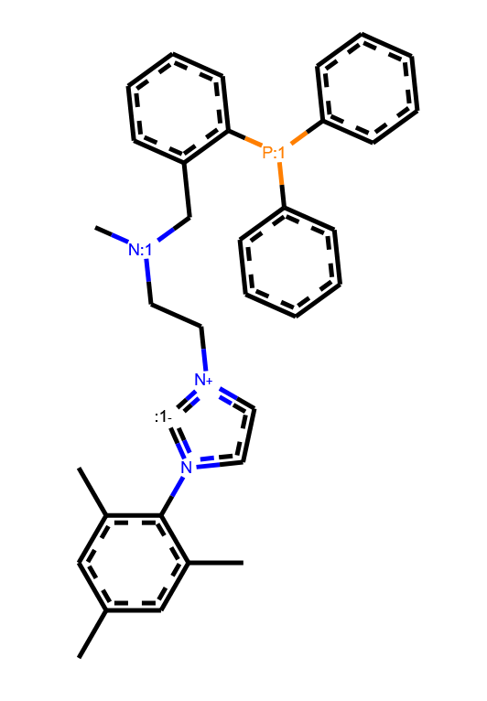
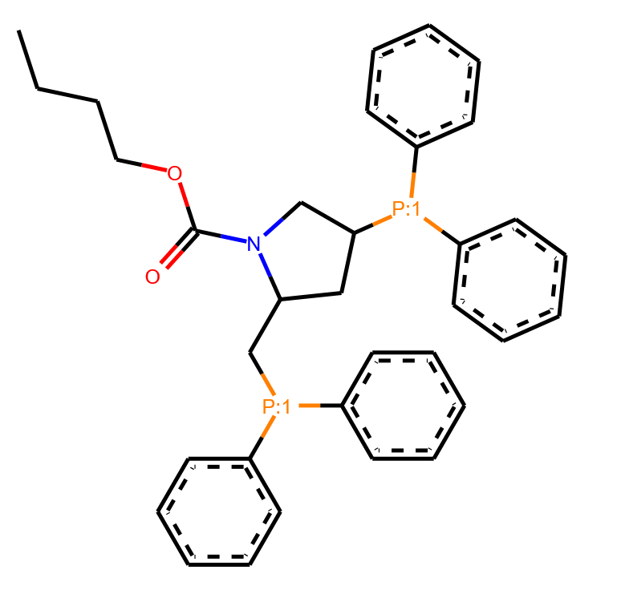
MACE (MetAl Complexes Embedding)
Code example
Define ligand SMILES
Define auxillary ligands
Define center atom (CA) and geometry
Create stereomers and conformers

Slide 29
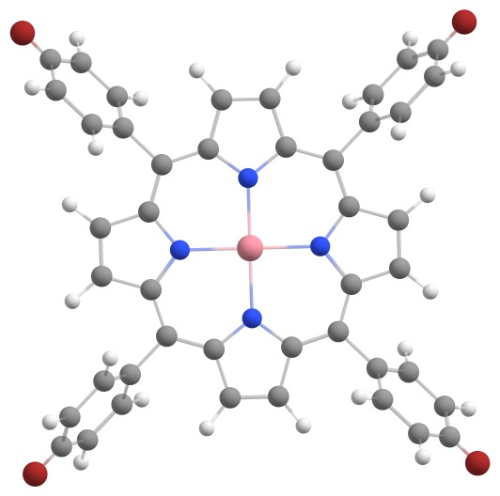
ChemSpaX
Ligand and complex permutations
Uses Openbabel for structure handling & conformer searching
Example case: Co-porphyrin
Notes:
Modifications in the first and second sphere can affect the reactivity
Using ChemSpaX, we screened various structures, but I will discuss our study of Mn(I) based catalysts in more detail

Slide 30
ChemSpaX
Code example
Define functionalization sites on the skeleton
Define used substituents
Define location of skeletons that will be functionalized
Notes:
Modifications in the first and second sphere can affect the reactivity
Using ChemSpaX, we screened various structures, but I will discuss our study of Mn(I) based catalysts in more detail

Slide 31

OBeLiX flowchart

Slide 32
OBeLiX - automated structure generation

Slide 33
OBeLiX - Descriptor calculation

Slide 34
OBeLiX - Descriptor calculation

Slide 35
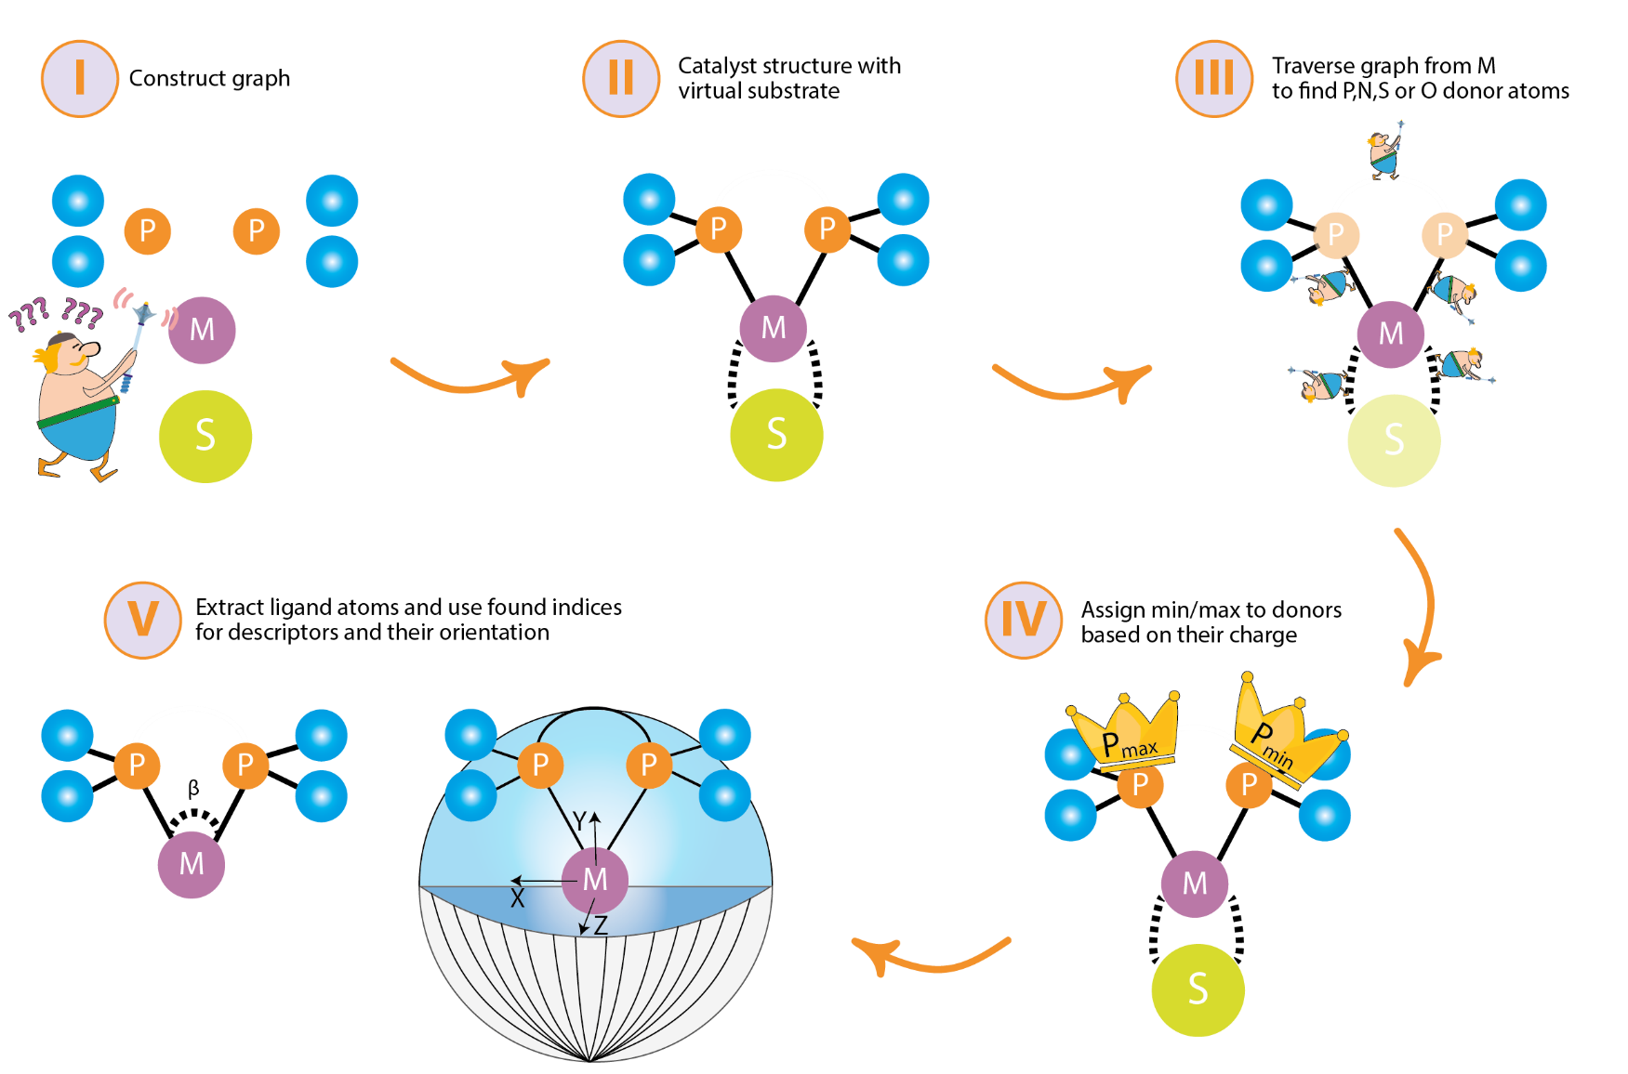
OBeLiX - Descriptor calculation

Slide 36
OBeLiX - Descriptor calculation
Uses Morfeus for xTB/steric/geometric descriptors
Uses cclib for electronic descriptors parsing DFT log files
Possible to calculate 4 sets of descriptors
Morfeus
NBD
DFT
Free ligand

Slide 37
OBeLiX – Free ligand descriptor calculation

Slide 38
OBeLiX flowchart

Slide 39
Alternatives
Structure generation
Molassembler
Architector
MolSimplify
Aaron
AQME
Descriptor calculation
AQME
ML pipeline
ROBERT

Slide 40
Summary
Questions, comments or ideas? a.v.kalikadien@tudelft.nl
Automation is key to high-throughput analysis
Data → Representation → Model → Analysis

Slide 41



Follow our progress!
Github
@EPiCs-group
@akalikadien
Twitter/X
@akalikadien
Chem. Sci
ChemPlusChem and JPCC

